Slide 1
Predicting NFL Games Using Machine Learning

Slide 2
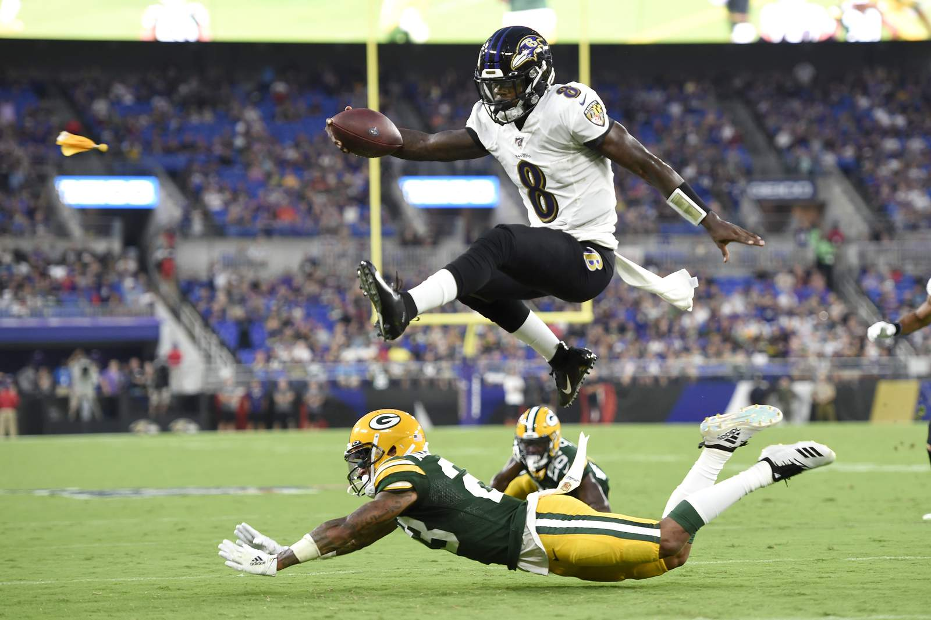
Is It Possible to Predict the Outcome of NFL Games
The NFL is a multi-billion dollar industry and is the most successful sports league in the nation.
The estimated value of American sports gambling is $150 billion annually.
Is it possible to predict NFL games at a high percentage to take advantage of sports gambling?

Slide 3
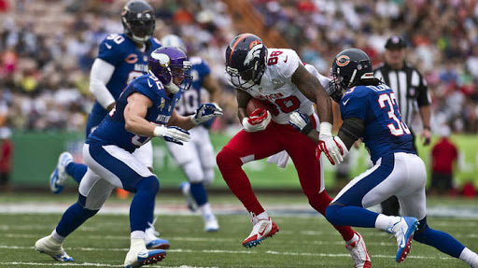
Method to Predict Games
Game data from past three years used to train model.
To predict games, I will use the average of the past 3 games played by each team.
After gathering data and knowing the outcome of each game, I then used the past 3 game averages to try to predict the outcome of each game in the past 3 years.

Slide 4
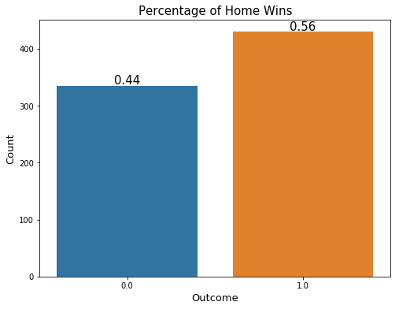
Visualizing the Data
Home team wins 56% of the time
Visiting team wins 44 % of the time
The model needs to be able to predict the outcome of games with an accuracy greater than 56%

Slide 5
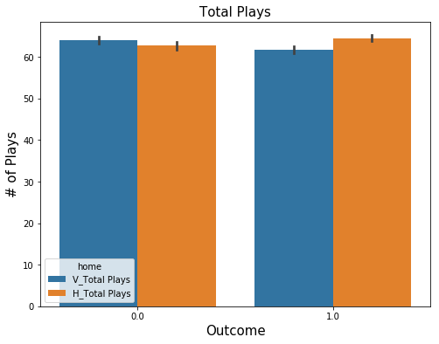
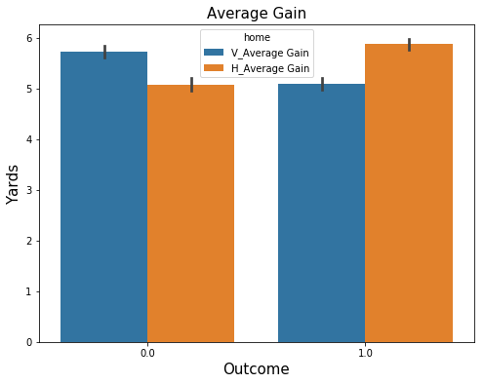
Visualizing the Data

Slide 6
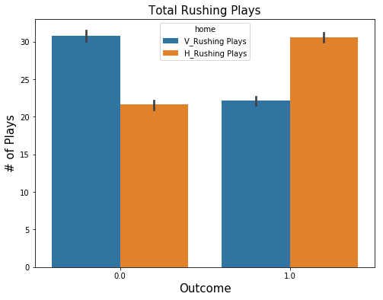
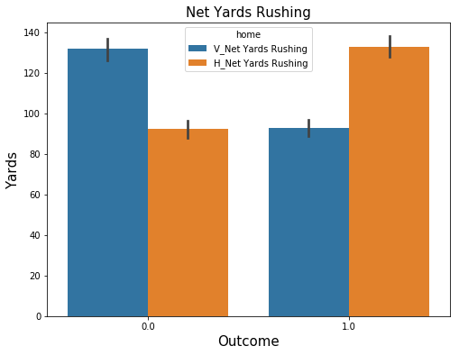
Visualizing the Data

Slide 7
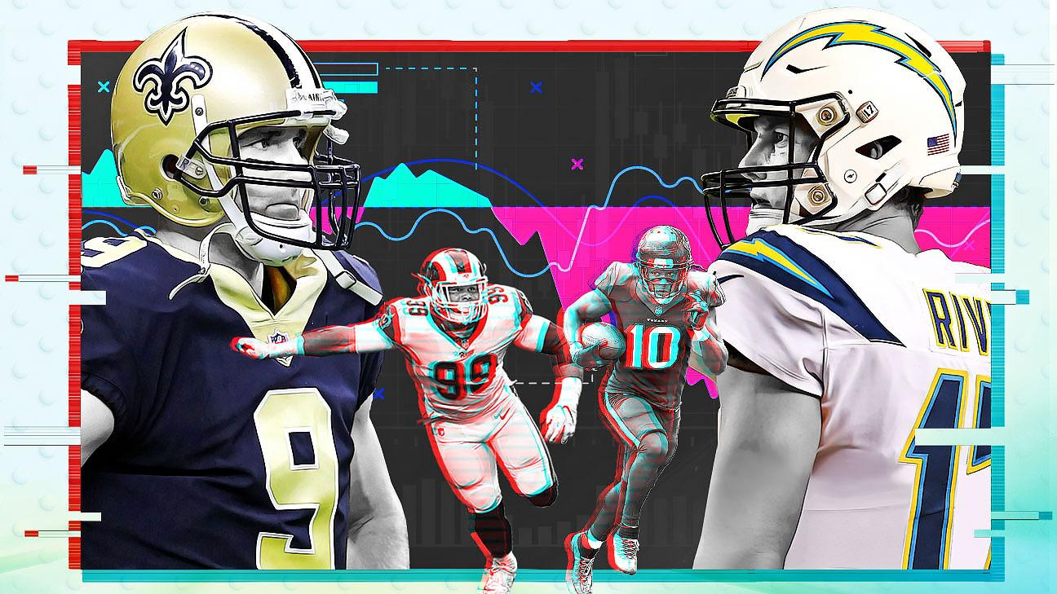
60.3%
Accuracy with best performing model.

Slide 8
Future Work
Some things to consider:
Model performance could be improved by introducing more game data that wasn’t used, such as defense/special teams data
Are there certain teams that play better at home? Is there a way to quantify that into data to use for predictions?
The model also does not take into account any injuries that may have occurred during the season

Slide 9
Thank you

